Slide 1
FORM GSTR 9C
By CA Shubham Khaitan, B.COM (Honours), ACA, ACS, CFA(USA), DISA (ICAI)
Partner - Tax & Regulatory, S. Khaitan & Associates
Email ID: shubham@cakhaitan.com, Phone No. 03340687062, +919831912725
Website: www.cakhaitan.com

Slide 2
Definition of audit as per Section 2(13)
“audit” means –
the examination of records, returns and other documents
maintained or furnished by the registered person
under this Act or the rules made thereunder or under any other law for the time being in force
to verify the correctness of turnover declared, taxes paid, refund claimed and input tax credit availed,
and to assess his compliance with the provisions of this Act or the rules made thereunder;

Slide 3
Audit under GST as per Sec 35(5)
Every registered person having turnover in FY > 2 Crore
Audit by Chartered / Cost Accountant
Submission of Audited annual accounts, reconciliation statement and other prescribed documents

Slide 4
Audit under GST as per Rule 80(3)
Every registered person having aggregate turnover in FY > 2 Crore
Get his accounts audited under section 35(5)
Submission of Audited annual accounts and reconciliation statement, duly certified in Form GSTR-9C on common portal

Slide 5
Serial No. 1 to 4
Financial Year
1st July 2017 to 31st March 2018
GSTIN
3A. Legal Name (to be auto-populated)
Reference to the PAN as given in the Registration certificate
3B. Trade Name (to be auto-populated)
Name used by trade and industry for identification of their business
Given in the registration certificate
4. Are you liable to audit under any Act? (To be specified)
Possible that an entity is liable for audit under several statutes (Co Act/Income Tax etc.)

Slide 6
Part II. Recon of turnover between financials & AR
Recon Adjustments
To match

Slide 7
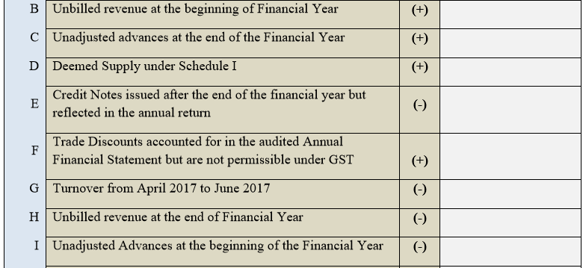
Recon Adjustments

Slide 8
Recon Adjustments

Slide 9
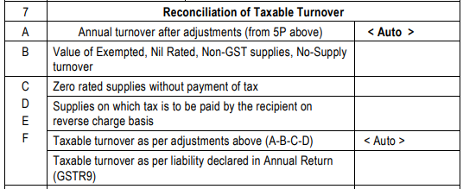
7. Recon of Taxable turnover
Adjustments
E
F
To match

Slide 10
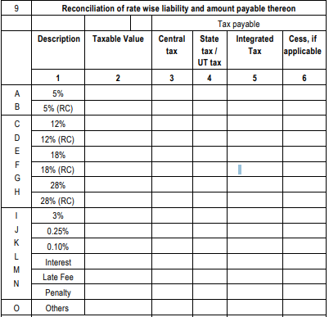
Part III. Reconciliation of Tax paid

Slide 11
Part III. Reconciliation of Tax paid

Slide 12
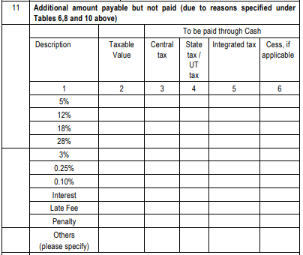
Part III. Reconciliation of Tax paid

Slide 13
Reasons for difference in tax liability
Missed/Lower reporting of any turnover in returns
Type of supply disputes (Taxable / Exempt etc.)
Classification disputes
Valuation issues
Time of supply disputes
Failure to pay the tax on time
Place of supply disputes
(Incorrect entry in books may not entail tax payment)

Slide 14
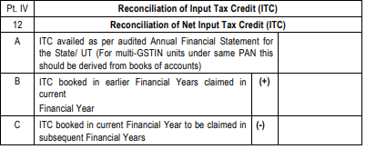
Part IV. Reconciliation of Input Tax Credit
To match

Slide 15
12F. Unreconciled ITC – Possible reasons
Breakup of GST not shown in the expenses/capital goods
Breakup of ineligible ITC shown in books
Receipt of excess credit from ISD as per books/return
ITC reversal/reclaimed not passed/incorrectly passed in books
ITC of another GSTIN claimed in returns
Duplicate ITC availed in returns

Slide 16
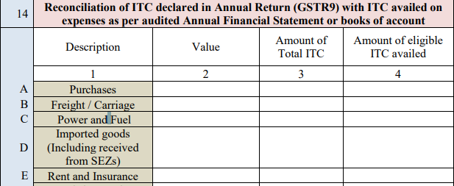
14. Recon of ITC in GSTR 9 with ITC availed on expenses as per books

Slide 17
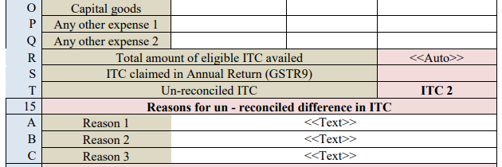
14. Recon of ITC in GSTR 9 with ITC availed on expenses as per books

Slide 18
15. Unreconciled ITC
ITC booked but not availed
ITC availed after the closure of books of accounts wherein no ITC was shown
Not in possession of proper tax invoice (claimed in books/returns)
Non-receipt of goods or services or both
ITC claimed even though depreciation claimed on tax component
Lower reversal of ITC made
ITC availed even though payment not made to supplier within 180 days
ITC blocked u/s 17(5) incorrectly claimed
Excess credit received from ISD

Slide 19
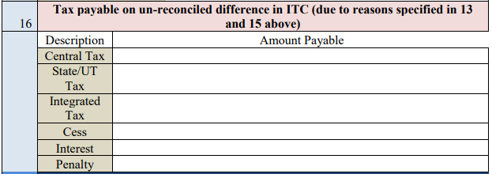
16. Tax payable on unreconciled difference in ITC

Slide 20
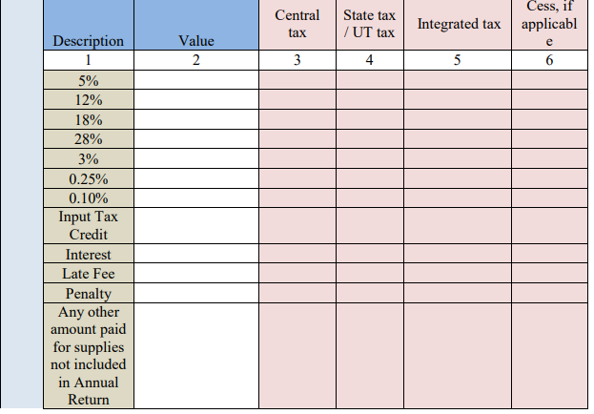
Part V. Auditor’s recommendation on addl liab due to non-recon

Slide 21
Part V. Auditor’s recommendation on addl liab due to non-recon

Slide 22
Part B – Certification –recon & audit by same person
Certification in cases where the reconciliation statement (FORM GSTR-9C) is drawn up by the person who had conducted the audit:
1. * I/we have examined the—
balance sheet as on ………
the *profit and loss account/income and expenditure account for the period beginning from ………..…to ending on ……., and
the cash flow statement for the period beginning from ……..…to ending on ………, — attached herewith, of M/s …………… (Name), …………………….………… (Address), ..…………………(GSTIN).

Slide 23
Part B – Certification –recon & audit by same person
2. Based on our audit I/we report that the said registered person—
*has maintained the books of accounts, records and documents as required by the IGST/CGST/<<>>GST Act, 2017 and the rules/notifications made/issued thereunder
*has not maintained the following accounts/records/documents as required by the IGST/CGST/<<>>GST Act, 2017 and the rules/notifications made/issued thereunder:
1.
2.
3.
3. (a) *I/we report the following observations/ comments / discrepancies / inconsistencies; if any:

Slide 24
Part B – Certification –recon & audit by same person
3. (b) *I/we further report that, -
*I/we have obtained all the information and explanations which, to the best of *my/our knowledge and belief, were necessary for the purpose of the audit/ information and explanations which, to the best of *my/our knowledge and belief, were necessary for the purpose of the audit were not provided/partially provided to us.
In *my/our opinion, proper books of account *have/have not been kept by the registered person so far as appears from*my/ our examination of the books.
I/we certify that the balance sheet, the *profit and loss/income and expenditure account and the cash flow Statement are *in agreement/not in agreement with the books of account maintained at the Principal place of business at ……………………and ** ……………………additional place of business within the State.

Slide 25
Part B – Certification –recon & audit by same person
4. The documents required to be furnished under section 35 (5) of the CGST Act and Reconciliation Statement required to be furnished under section 44(2) of the CGST Act is annexed herewith in Form No. GSTR-9C.
5. In *my/our opinion and to the best of *my/our information and according to explanations given to *me/us, the particulars given in the said Form No.GSTR-9C are true and correct subject to following observations/qualifications, if any:
……………………………………………………………………………………
……………………………………………………………………………………
…………………………………………………………………………………… ………………………………………

Slide 26
Part B – Certification –recon & audit by diff person
I/we have examined the—
(a) balance sheet as on ………
(b) the *profit and loss account/income and expenditure account for the period beginning from ………..…to ending on ……., and
(c) the cash flow statement for the period beginning from ……..…to ending on ………, — attached herewith, of M/s …………… (Name), …………………….………… (Address), ..…………………(GSTIN).

Slide 27
Part B – Certification –recon & audit by diff person
2. Based on our audit I/we report that the said registered person—
*has maintained the books of accounts, records and documents as required by the IGST/CGST/<<>>GST Act, 2017 and the rules/notifications made/issued thereunder
*has not maintained the following accounts/records/documents as required by the IGST/CGST/<<>>GST Act, 2017 and the rules/notifications made/issued thereunder:
1.
2.
3

Slide 28
Part B – Certification –recon & audit by diff person
3. The documents required to be furnished under section 35 (5) of the CGST Act and Reconciliation Statement required to be furnished under section 44(2) of the CGST Act is annexed herewith in Form No.GSTR-9C.
4. In *my/our opinion and to the best of *my/our information and according to examination of books of account including other relevant documents and explanations given to *me/us, the particulars given in the said Form No.9C are true and correct subject to the following observations/qualifications, if any:
…………………………….…………………………….………………………
…………………………….…………………………….………………………
…………………………….…………………………….………………………

