Slide 1


“Managing Cost &
Business Decisions”
37th Cost Conference
The Institute of Cost Accountants of India
June 11, 2016 – Science city, Kolkata
Kalyan Kar
Co-Founder & Managing Director – Inthink Knowledge Ventures

Slide 2
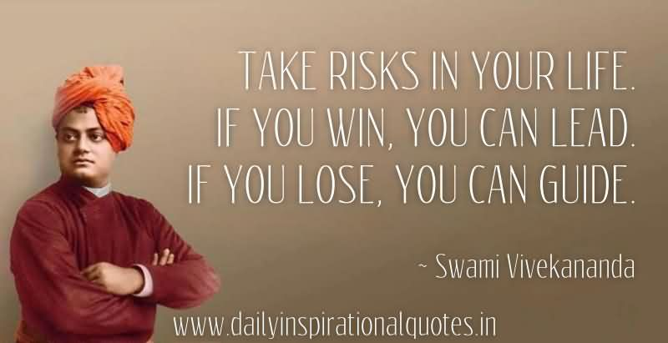
Notes:
Yesterday Focus on leveraging social, mobile, analytics, and cloud (SMAC) to transform your enterprise into a digital business.
Today, the challenge has become: what will business leaders do with their digital advantage?
Mastering the shift from “me” to “we.”
Tapping into a broad array of other digital businesses, digital customers, and even digital devices at the edge of their networks.
“Big Is the Next Big Thing.”
The Internet of Things (IoT)

Slide 3

Start-up Founders
The Openers
The Middle Orders
The Tail Enders
Notes:
Yesterday Focus on leveraging social, mobile, analytics, and cloud (SMAC) to transform your enterprise into a digital business.
Today, the challenge has become: what will business leaders do with their digital advantage?
Mastering the shift from “me” to “we.”
Tapping into a broad array of other digital businesses, digital customers, and even digital devices at the edge of their networks.
“Big Is the Next Big Thing.”
The Internet of Things (IoT)

Slide 4
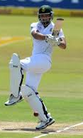
The Openers
Fearless – Dreamer – Enthusiastic – Unspoilt !!!
Can’t let go with growth
Managing high end people
Managing scaling up
Too hands on…at times
at the cost of growth
Notes:
Yesterday Focus on leveraging social, mobile, analytics, and cloud (SMAC) to transform your enterprise into a digital business.
Today, the challenge has become: what will business leaders do with their digital advantage?
Mastering the shift from “me” to “we.”
Tapping into a broad array of other digital businesses, digital customers, and even digital devices at the edge of their networks.
“Big Is the Next Big Thing.”
The Internet of Things (IoT)

Slide 5
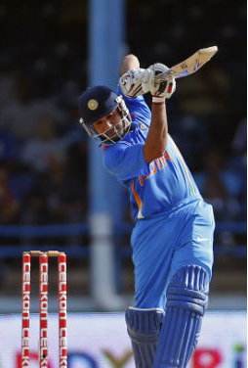
The Middle Orders
The Rock Stars !!! ☺
They think they KNOW
They think it is NOW
They think they CAN
…Well, NONE of the above is True !!!
Notes:
Yesterday Focus on leveraging social, mobile, analytics, and cloud (SMAC) to transform your enterprise into a digital business.
Today, the challenge has become: what will business leaders do with their digital advantage?
Mastering the shift from “me” to “we.”
Tapping into a broad array of other digital businesses, digital customers, and even digital devices at the edge of their networks.
“Big Is the Next Big Thing.”
The Internet of Things (IoT)

Slide 6
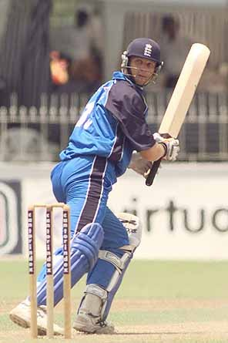
The Tail Enders
The Successful Seniors !!!
Can’t let go with halo – they said “Sir” to your CHAIR and NOT to YOU ☺
Can’t stoop down to build
a Team
Can’t manage small scale
Too executive and less cost conscious …thereby making
things non-viable
Notes:
Yesterday Focus on leveraging social, mobile, analytics, and cloud (SMAC) to transform your enterprise into a digital business.
Today, the challenge has become: what will business leaders do with their digital advantage?
Mastering the shift from “me” to “we.”
Tapping into a broad array of other digital businesses, digital customers, and even digital devices at the edge of their networks.
“Big Is the Next Big Thing.”
The Internet of Things (IoT)

Slide 7
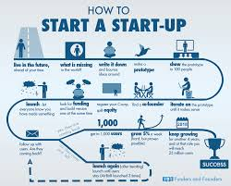
The Start-up Business Plan
Concept
Validation
Viability
Marketability
Subject Knowledge
Vision Document
Entry & Exit
Plan – Execute – Review – Re plan
Notes:
Yesterday Focus on leveraging social, mobile, analytics, and cloud (SMAC) to transform your enterprise into a digital business.
Today, the challenge has become: what will business leaders do with their digital advantage?
Mastering the shift from “me” to “we.”
Tapping into a broad array of other digital businesses, digital customers, and even digital devices at the edge of their networks.
“Big Is the Next Big Thing.”
The Internet of Things (IoT)

Slide 8

The Entrepreneurs Dilemma
Cash Flow or Profitability
Growth or Stability
Buy or Rent
Invest vs Expense
Asset vs Liability
Principal vs Practicality
Incur Loss or Scale Down
Commitment of Convenience
Notes:
Yesterday Focus on leveraging social, mobile, analytics, and cloud (SMAC) to transform your enterprise into a digital business.
Today, the challenge has become: what will business leaders do with their digital advantage?
Mastering the shift from “me” to “we.”
Tapping into a broad array of other digital businesses, digital customers, and even digital devices at the edge of their networks.
“Big Is the Next Big Thing.”
The Internet of Things (IoT)

Slide 9
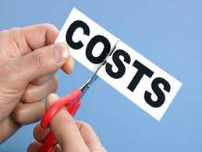
Questions to Manage Cost
What ?
Why ?
When ?
How Much ?
How ?
Rule of Thumb -
Always think if it was “YOUR” money then what decision would you have taken ?
Notes:
Yesterday Focus on leveraging social, mobile, analytics, and cloud (SMAC) to transform your enterprise into a digital business.
Today, the challenge has become: what will business leaders do with their digital advantage?
Mastering the shift from “me” to “we.”
Tapping into a broad array of other digital businesses, digital customers, and even digital devices at the edge of their networks.
“Big Is the Next Big Thing.”
The Internet of Things (IoT)

Slide 10

Remember
Accept mistakes and move on
Remember “Receivable” is NOT an Asset BUT “Payable” is a Liability
KNOW your subject
Prioritize in Cash Constraints
Timing of Expenses
Core Values – ROI
Remember Cash is KING
Projections NEVER match
Business Evolves Every Day
Customer is the KING
Notes:
Yesterday Focus on leveraging social, mobile, analytics, and cloud (SMAC) to transform your enterprise into a digital business.
Today, the challenge has become: what will business leaders do with their digital advantage?
Mastering the shift from “me” to “we.”
Tapping into a broad array of other digital businesses, digital customers, and even digital devices at the edge of their networks.
“Big Is the Next Big Thing.”
The Internet of Things (IoT)

Slide 11
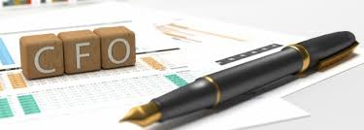
….AND Remember
Encourage your CFO to “Question” you – HE is your TRUE Gate Keeper ☺
Notes:
Yesterday Focus on leveraging social, mobile, analytics, and cloud (SMAC) to transform your enterprise into a digital business.
Today, the challenge has become: what will business leaders do with their digital advantage?
Mastering the shift from “me” to “we.”
Tapping into a broad array of other digital businesses, digital customers, and even digital devices at the edge of their networks.
“Big Is the Next Big Thing.”
The Internet of Things (IoT)

Slide 12
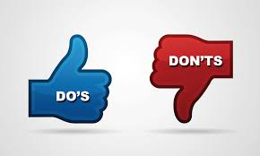
Start-up DO’s & Don’ts
Think Big Act Small
Bootstrap ☺
Manage cash EVERYDAY
Do NOT have excess cash ☺
Do NOT spend in anticipation
Decide “Need vs Good” to have
Work Smartly – use Technology
MIS – Data – Analytics – Metrics
Cash Flow constraint HELPS -
that will help you learn to manage cost
Make Money First – Spend Money Next
Measure EVERY Expense –
Do NOT Spend if you CANNOT Measure
Notes:
Yesterday Focus on leveraging social, mobile, analytics, and cloud (SMAC) to transform your enterprise into a digital business.
Today, the challenge has become: what will business leaders do with their digital advantage?
Mastering the shift from “me” to “we.”
Tapping into a broad array of other digital businesses, digital customers, and even digital devices at the edge of their networks.
“Big Is the Next Big Thing.”
The Internet of Things (IoT)

Slide 13
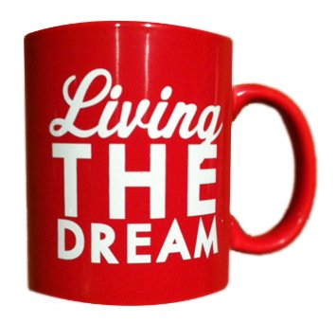
To ALL Start-up Dreamers -
Be Passionate
Stretch Yourself
Create Wealth
Notes:
Yesterday Focus on leveraging social, mobile, analytics, and cloud (SMAC) to transform your enterprise into a digital business.
Today, the challenge has become: what will business leaders do with their digital advantage?
Mastering the shift from “me” to “we.”
Tapping into a broad array of other digital businesses, digital customers, and even digital devices at the edge of their networks.
“Big Is the Next Big Thing.”
The Internet of Things (IoT)

Slide 14
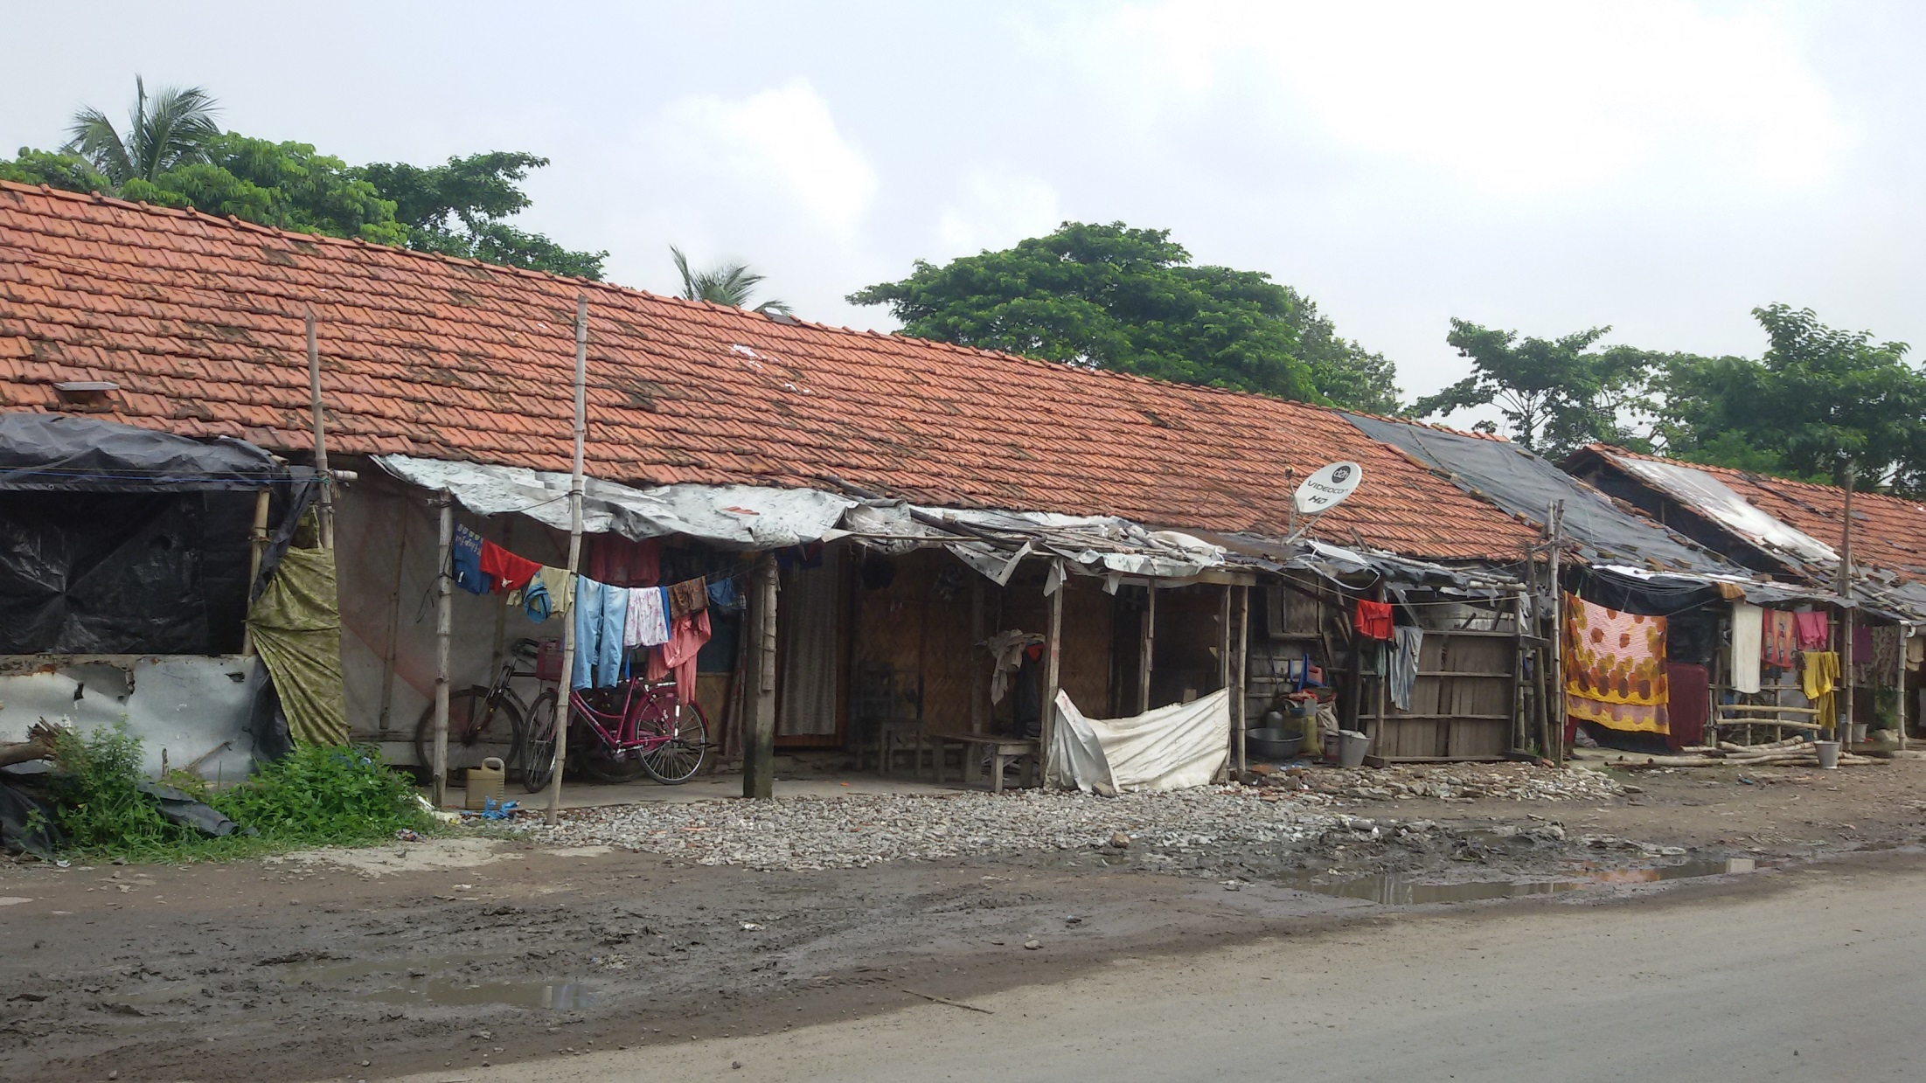
India, truly, is a country of 1.25 Billion Opportunities !!

Slide 15
Thank You !!!
Kalyan.kar@ikvpl.com

