Slide 2
FINANCIAL MARKETS
A mechanism that allows people to participate in trade.
Consisting of……
CAPITAL MARKET
DEBT MARKET
FOREX MARKET
COMMODITY MARKET
MONEY MARKET
MUTUAL FUNDS

Slide 3
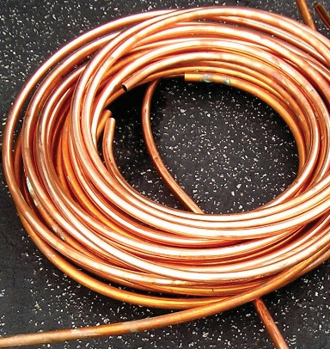
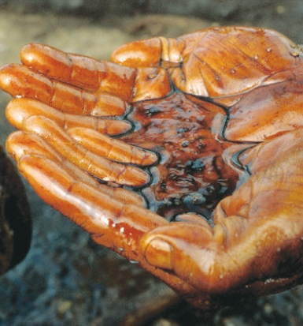
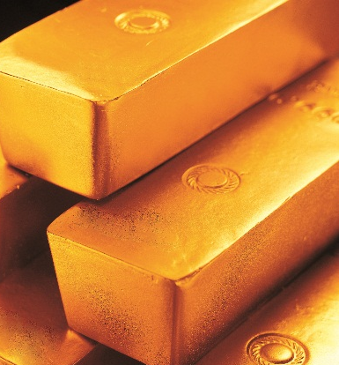
COMMODITY MARKET
Commodities
Agriculture
Base Metals
Energy
Bullion
Valuations in the Commodity markets are impacted by exchange
rates, Interest rates, demand & supply, weather etc.

Slide 4
Two Major Functions of Commodity Futures Market
Price Discovery
Price Risk Management
These two functions have created a host of associated spill-over benefits

Slide 5
Risks across a simple commodity value chain
Producers – Uncertainty in commodity price realisation
Traders – Uncertainty in profit expectations
Consumers – Uncertainty in commodity price outflow
If risks are hedged across the value chain, then
Final commodity price = Value of raw material + value additions only

Slide 6
Solution - Hedging
Hedging involves off-setting an existing or anticipated risk in the (physical) business by taking opposite position on the Exchanges to mitigate the price risk.
Hedge transactions on exchange are designed to ‘lock-in’ a particular price and thereby to protect the normal profits from adverse price fluctuations.

Slide 7
Economic Benefits
Price Discovery leading to referenceable benchmark pricing
Price Risk Management, esp. for SMEs and farmers
Provides a view on the future direction of the market
Price dissemination
Benefit to Consumers/Industrialists
Time to buy
Hedging
Lower cost for procurement
Benefit to farmers
Choice of crop
Time to sell
Increased awareness about quality standards
Integration of rural, urban and global markets
Warehouse based funding
Rising investment in market related infrastructure (e.g. standardization/quality testing/warehousing)
Benefit – Investment, employment generation and penetration of financial services to rural India.

Slide 8
Indian Derivatives Sector Overview
Ministry of Finance
SEBI
Commodity Exchanges
National Exchanges
Regional Exchanges

Slide 9
THANK YOU

