Slide 1


National Pension System
An Overview

Slide 2
About NSDL
Established in November 1996 as a depository
  Promoters - IDBI, Unit Trust of India (now SUUTI) and NSE
Developed state of the art national infrastructure
Transformed capital market operations in India
Engaged by GoI for developing various e-Governance solutions
Developed and managing various turnaround Greenfield projects
Notes:
Robust organisation having the credibility to maintain data and effectively service stakeholders for decades

Slide 3
Governance Structure
PFRDA Bill passed in parliament in 2013 and Act was notified in February 2014
Notified regulations for all stakeholders
NPS Trust has been formed to safeguard subscriber’s interest
  Stringent SLA with all stakeholders
  Online Grievance Management System linking all stakeholders
Appointment of Pension Advisory Council
3
Notes:
National Pension System (NPS) was launched in January 1, 2004 for Central Government Employees
NPS made available to Non Government Sector from May 2009
Corporate Sector launched in December 2011
Registered Offices: 4.6 Lakhs
Registered Subscribers:1.27 Crore
Eminent personalities has been appointed as Trustees

Slide 4
Statistics
NPS
Central Government
State
Government
All Citizens
of India
Corporate
Sector
NPS Lite /
APY
16.85 lakh
30.05 lakh
2.33 lakh
4.87 lakh
81.16 lakh
Total Contribution almost Rs. 99,000 Cr
Total Asset Under Management in excess of Rs. 1.23.000 Cr
4
Notes:
NPS caters to five sectors
NPS started with CG on January 1, 2004. Subsequently it was made available to SG.
In May 2009, All Citizens of India was launched and later in December 2011, Corporate sector was launched
NPS Lite is an extention of NPS for the economically weaker sections of society to cater to their need for pension
More than 58 lacs subscribers have been registered so far

Slide 5
Features of NPS
Open for all Indian citizens between 18 – 60 years
Unique and Portable Permanent Retirement Account Number (PRAN) with complete online access
Tier I & Tier II
Nomination facility
Choice of PFM and Asset Allocation
Tax Benefit under 80C, 80CCD(2) as well as 80CCD(1B)
Switch of funds allowed from Tier II to Tier I
(No Tax incidence)
5
Notes:
* = Tax will not be levied on the amount which is transferred for purchase of Annuity

Slide 6
Unique Tax Benefit
Employer Contribution:
Deduction upto 10% of salary (Basic + DA) from taxable income u/s 80 CCD(2). This is over and above the limits u/s 80C.
Employee Contribution:
Deduction upto 10% of salary (basic+ DA) within overall ceiling Rs.1.50 Lakh u/s 80C.
Voluntary Contribution:
Deduction upto Rs.50,000 u/s 80 CCD(1B) from taxable income for additional contribution to NPS.
Tax benefit to Subscriber
Employer’s Contribution can be deducted as ‘Business Expense’ from their Profit & Loss Account
6

Slide 7
Benefit of 80CCD(1B) & 80CCD(2)
Particulars | Salary Rs. 12 Lakhs |  | Salary Rs. 24 Lakhs
 | Without NPS | With NPS | Without NPS | With NPS
Basic (50% of Gross) | 6,00,000 | 6,00,000 | 12,00,000 | 12,00,000
NPS contribution | - | 60,000 | - | 1,20,000
Other Taxable Allowances / Perks | 6,00,000 | 5,40,000 | 12,00,000 | 10,80,000
Gross Total Income | 12,00,000 | 12,00,000 | 24,00,000 | 24,00,000
Less: Deductions
-- Section 80C | 1,50,000 | 1,50,000 | 1,50,000 | 1,50,000
-- Section 80CCD(1B) | - | 50,000 | - | 50,000
-- Section 80CCD(2) | - | 60,000 | - | 1,20,000
Taxable Total Income | 10,50,000 | 9,40,000 | 22,50,000 | 20,80,000
Tax on Total Income | 1,44,200 | 1,16,390 | 5,15,000 | 4,62,470
Tax Savings | - | 27,810 | - | 52,530
This is saving for a single year
7
Notes:
If benefit of 80CCD(1B) is added, another Rs. 15,000 of tax is saved per year.

Slide 8

Unique tax benefit for NPS
Additional Tax benefit of Rs. 50,000 u/s 80CCD(1B)
Investment | With NPS | Without NPS
Tax Slab | - | 20% | 30%
Amount | 50,000 | 40,000 | 35,000
After 15 years of Investment
Corpus at @ 8% | 13.6 lacs | 10.9 lacs | 9.5 lacs
Corpus at @ 10% | 15.9 lacs | 12.7 lacs | 11.1 lacs
Diff in Corpus | - | 25% | 43%
8
Notes:
in last 36 years .... Sensex gave a return of 16.9%
https://www.easycalculation.com/mortgage/future-value-for-ordinary-annuity.php

Slide 9
Returns
  Retail Domestic Term Deposit rates*
    1999 - 10.50 %
    2009 - 8.50 %
    2016 - 7.00 %
  Government Sector schemes have delivered annualised returns of 9.63% to 10.11% since April 2008
  For Non Government Sector (Annualised returns for 3 year)
    Scheme E – Tier I – 12.63% to 13.44%
    Scheme C – Tier I – 9.78% to 10.50%
    Scheme G – Tier I – 9.03% to 9.45%
Available at NPS Trust Website http://www.npstrust.org.in/index.php/navreturns/returns
* For SBI in % p.a. (below Rs. 1 crore) for 10 years
9

Slide 10




Exit Process
  Upon attainment of the age of 60 years
  At any time before attaining the age of 60 years (after 10years)
  Death of the subscriber
Deferred withdrawal up to the age of 70 years
Deferred Annuity for 3 years
Contribution allowed beyond the age of 60 years
Online withdrawal process for easy exit
10
Notes:
At the age of 60, at least 40 % of the corpus needs to be used to buy annuity from empanelled ASPs. This will provide pension to the subscriber. The remaining amount can be withdrawn in lump sum.
The subscriber has the option to keep the money in the system till the age of 70 after mandatorily exiting the same at the age of 60.
Option to withdraw the entire accumulated pension wealth in a case of amount is equal to or less than Rs.2,00,000/-
80-20: At least 80% of the accumulated pension wealth of the subscriber needs to be utilized for purchase of an annuity providing for monthly pension to the subscriber and balance is paid as lump sum payment to the subscriber
Death Case: The entire accumulated pension wealth (100%) would be paid to the nominee / legal heir of the subscriber and there would not be any purchase of annuity/monthly pension.
It is worth mentioning that the Subscriber also has an option of deferring his lumpsum withdrawal by 10 years wherein at the age of 60 years he would have been in a higher tax bracket than when he withdraws at the age of 70 years.
Additionally this deferment of lump sum withdrawal also comes in handy to safeguard the Subscriber from the risk of the market wherein the market is going through a slump at the time of withdrawal.
These are the seven IRDA regulated insurance companies empanelled by PFRDA to provide the pension services to the Subscribers.
Typically there are two type of annuity plan, annuity with capital return and annuity without capital return.
Typically annual pension for Rs. 1000 is around Rs. 70
Subscriber have the option to choose the following types of insurance schemes
Annuity/ pension payable for life at a uniform rate.
Annuity payable for 5, 10, 15 or 20 years certain and thereafter as long as the annuitant is alive.
Annuity for life with return of purchase price on death of the annuitant.
Annuity payable for life increasing at a simple rate of 3% p.a.
Annuity for life with a provision of 50% of the annuity payable to spouse during his/her lifetime on death of the annuitant.
Annuity for life with a provision of 100% of the annuity payable to spouse during his/her lifetime on death of the annuitant.
Annuity for life with a provision of 100% of the annuity payable to spouse during his/ her life time on death of annuitant. The purchase price will be returned on the death of last survivor.
Annuity options for Government employees are being discussed

Slide 11
NPS v/s Superannuation
Features | NPS | Superannuation
Inflation adjusted return |  | X
Transparent / Low cost structure |  | X
Customised Portfolio (amount & asset class) |  | X
24X7 access |  | X
Seamless portability |  | X
Periodic cash flow |  | X
Choice of Annuity |  | X
11
Notes:
LIC, who is the major player in superannuation space also acts as a PFM as well as ASP. So the expertise LIC can be availed through NPS also at a lower cost.
Moreover, NPS offers option to choose from multiple choice of Annuity.

Slide 12
NPS v/s Superannuation
Features | NPS | Superannuation
Tax Benefit | 10% of Basic + DA (no monetary cap) | Upto 1.5 LPA
Lumsum withdrawal on Retirement | Upto 60% | Upto 33%
Formation of Trust | Not required | Required
Coordination with IT Commissioner | Not Required | Required
Subscriber Servicing | Point of Presence / CRA | Employer
Existing corpus under Superannuation can now be transferred to NPS without any Tax incidence
12

Slide 13
Flexibility in Implementation
Can be implemented on a voluntary basis
Can be made mandatory for a section of employees based on
  Designation
  Date of joining
Contribution from either the employer or the employee or both
Scheme selection at Corporate / Employee level
13

Slide 14
Ease of Implementation
Register though Point of Presence (Bank / Non-Bank)
Register / contribute online through eNPS
Tag your PRAN to your employer once NPS is implemented in your organization
Switch your contribution in Superannuation to NPS
Stay informed through alerts and 24X7 online access
PRAN generation
PRAN Kit desptach
Contribution credit & Change of details
Monthly
e-Statement
Quarterly Balance
14

Slide 15

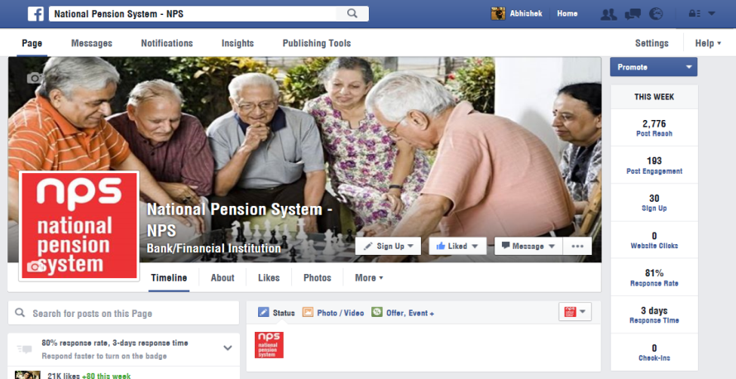


Let’s keep in touch
www.npscra.nsdl.co.in
facebook.com/nps.NSDL
Tel: 022-40904242
Helpline-:1800 222 080
Email: info.cra@nsdl.co.in

Slide 16
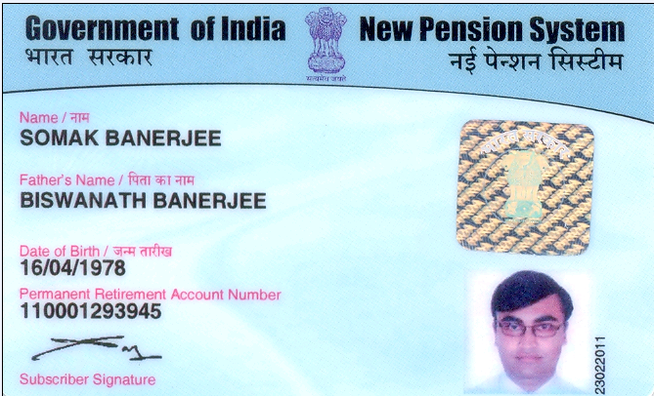
PRAN Card View

Slide 17
Two Tier Structure
Tier I
Pension Account
Mandatory
Tier II
Investment Account
Optional
Multiple Tax Benefit
Anytime withdrawal without exit load
Employer contribution in Tier I
Tier I is mandatory for opening Tier II
17
Notes:
No limit on number and amount of contribution

Slide 18







PFMs under NPS

Slide 19
Schemes / Investment Approach
Active Choice
Subscriber decides allocation pattern amongst E, C and G
Asset Class | Cap on Investment
Equity (E) | 50%
Corporate Bonds (C) | 100%
Government Securities (G) | 100%
Auto Choice
Funds managed on the pattern of a lifecycle fund
Age (in Years) | Asset Class E | Asset Class C | Asset Class G
Upto 35 | 50% | 30% | 20%
36 | 48% | 29% | 23%
37 | 46% | 28% | 26%
- | - | - | -
55 and Above | 10% | 10% | 80%
Investment Option can be changed once in a financial year
No Tax incidence due to switch of funds
19

Slide 20





Stakeholders in NPS
Central Recordkeeping
Agency
Point of Presence
Pension Fund Manager
Subscribers
20
Notes:
NPS works on an unbundled architecture wherein different entities come under one umbrella to operationalise a system.
Each entity is given the responsibility based on their core competence.
Each entity has limited access to data based on the responsibility it performs
CRA is not just a repository of data, forms and KYC documents
CRA provides the operational platform connecting all the entities

Slide 21
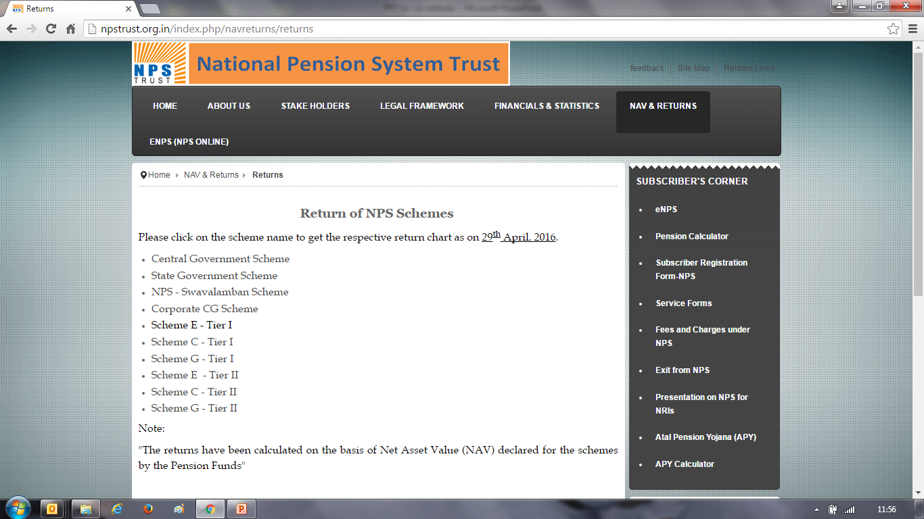

Slide 22
Growth of subscriber in Govt sector
22
Notes:
NPS works on an unbundled architecture wherein different entities come under one umbrella to operationalise a system.
Each entity is given the responsibility based on their core competence.
Each entity has limited access to data based on the responsibility it performs
CRA is not just a repository of data, forms and KYC documents
CRA provides the operational platform connecting all the entities

Slide 23
Subscriber Charge Structure
Intermediary | Charge Head | Charges (excluding Tax) | Method of Recovery
POP | Initial Registration charges | Rs.125 | Upfront collection
 | Any contribution | 0.25% of the amount, subject to minimum of Rs.20/-
 | Any other transaction not involving a contribution from subscriber | Rs.20
CRA | One time Account opening charge | Rs.50 | Redemption of units on a quarterly basis
 | Annual Maintenance Charge | Rs. 190
 | Transaction (contribution, change in scheme preference, switch and withdrawal) | Rs.4
23

Slide 24
Effect of charges on corpus
Investing Rs. 25,000 per annum for 25 years
Charges for Option A is 0.25% and Option B is 2.25%
Return on Investment (CAGR) for both the investment options is 10%
Corpus under Option A will be 23.6 Lacs
Corpus under Option B will be 17.6 Lacs
24

Slide 25
Ease of Access
Access to bi-lingual Interactive Voice Response (IVR) using T-PIN
View details / Change of contact details, scheme preference using I-PIN
Instant reset of T-PIN & Online reset of I-PIN through OTP
Online complaint resolution platform
Easy access to information through dedicated website and Facebook
25

Slide 26
Prerequisite for Implemetation
    Shortlisting POP
    Deciding on implementation parameter
      Voluntary / Mandatory
      Co-contribution
      Scheme preference
    Internal Approval for selecting POP
    Signing agreement with POP
    Disseminating information to employees
26

Slide 27
Interim Withdrawal
  Withdrawal will be allowed subject to
    Subscriber should be in NPS for 10 years
    Amount should not exceed 25% of the contributions made by the subscriber
    Withdrawal can happen only against specified reasons
Withdrawal option are limited to ensure sufficient terminal corpus
27

Slide 28
Promoters & Shareholders
  Promoters
  Industrial Development Bank of India
  Unit Trust of India (now SUUTI)
  National Stock Exchange
Shareholders
• State Bank of India • Citibank
• Canara Bank • Deutsche Bank
• Dena Bank • Standard Chartered Bank
• Oriental Bank of Commerce • HSBC
• Union Bank of India • HDFC Bank
• Axis Bank

Slide 29
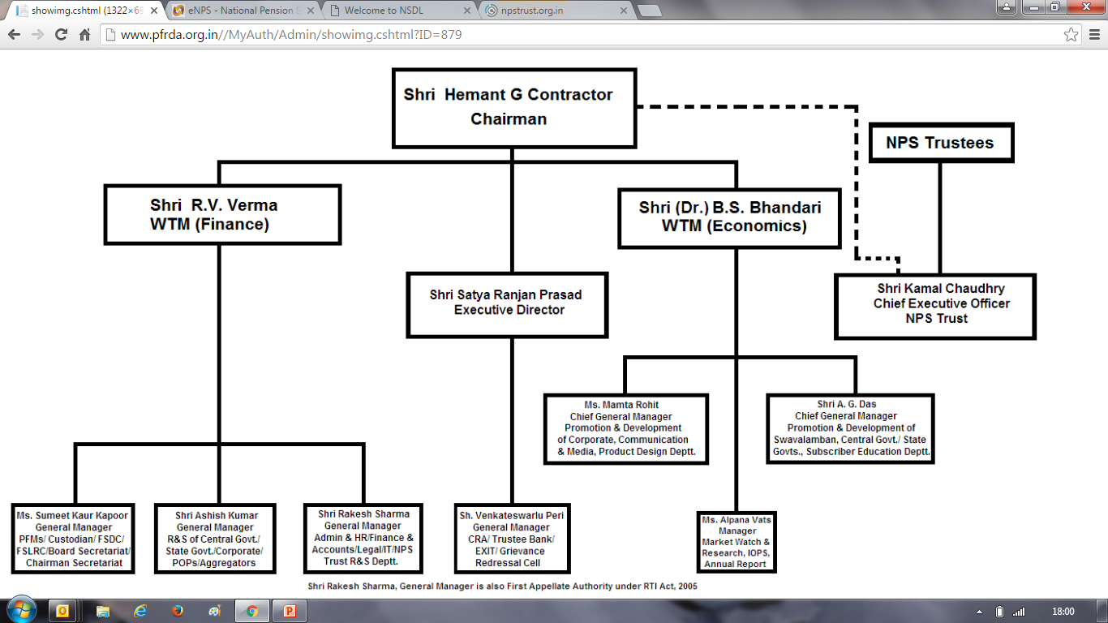
PFRDA Org Chart

Slide 30
NPS Trustee
Sh. Shailesh V. Haribhakti - Chairman & Trustee
  Fellow Chartered Accountant and the Chairman of BDO Consulting Pvt. Ltd.
  Serves on the Board of over ten large Indian Companies and Chairs ten Audit Committee
  Participated in the process of framing regulations and standards with forums like ASSOCHAM, CII and Indian Merchants’ Chamber
  Member of Corporate Governance Committee of CII, member and past chairman, Corporate Governance Committee ASSOCHAM
Smt. Pallavi S. Shroff
  Leads the competition law practice at Shardul Amarchand Mangaldas & Co
Sh Pramod Kumar Rastogi
  Former member Telecom Disputes Settlement and Appellate in the rank of Secretary to Government of India.
  Former Secretary Ministry of Steel, retired on 31.10.2009
  Principal Secretary (Finance), Government of Andhra Pradesh, Finance and Planning Department

Slide 31
NPS Trustee
Sh. Ashvin Parekh
  Associated with Ernst & Young as a Senior Expert – Advisor
  Served Deloitte Touche Tohmatsu India Pvt. Ltd. as Executive Director
  Held senior positions in Arthur Anderson, Price Waterhouse Coopers, KPMG India, KPMG UK, KPMG Dubai and Hindustan Lever Ltd.
  In the last 5 years he has been on 9 committees set up by the Finance Minister / Ministry of Finance
Sh. N. D. Gupta
  Has been involved in providing, auditing, taxation & financial consultancy services to some of the top institutions of India like RBI, SBI, NTPC, Local self-governments, Municipal bodies and is on the board of many public companies as Independent director.
  served as the President of Institute of Chartered Accountants of India (ICAI)
Sh. Bijay Kumar
  An IAS of ’86 batch, he is working as the Principal Secretary (Financial Reforms), Government of Maharashtra

Slide 32
NPS Trustee
Sh. Alok Tandon
  Joined Indian Administrative Service in 1986 and was allotted UP Cadre. He has held various positions in the Government of UP including Joint Secretary, Deptt. Of Heavy Industries and District Magistrate of 3 Districts – Maharganj, Allahabad and Varanasi
  He is holding the post of Joint Secretary, Ministry of Finance, Government of India since October 2011

