Slide 1
Total Cost Management in Mining Sector-best practices
Sunil Baran Mahapatra FCA

Slide 2
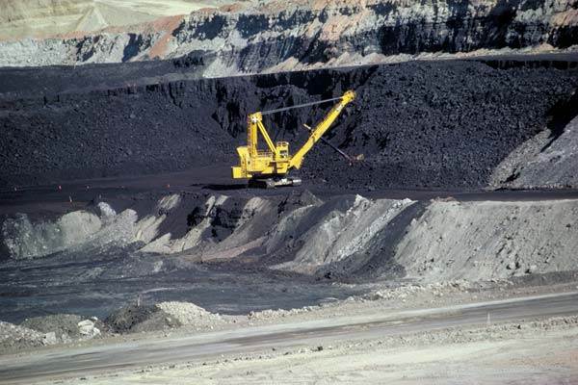
Coal Mining

Slide 3
Cost break up of CIL

Slide 4
Installed Power Capacity: 01.04.2016

Slide 5
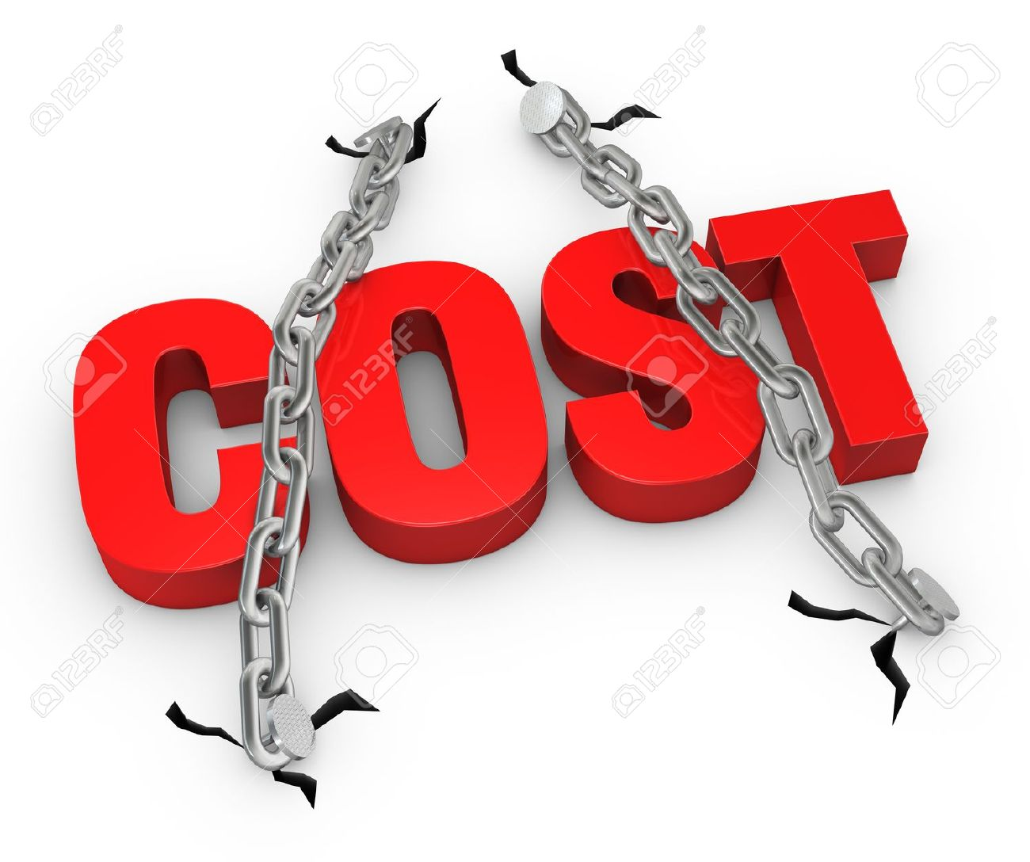
Cost Management Perspective

Slide 6
Why TCM for Coal Mining Sector in India
Cost is mostly Site specific-benchmarking of cost is not very meaningful.
High Fixed cost-OPL,BEP are high.
Little scope for product differentiation.
Energy elasticity &Coal dependency.
Cost of renewable energy-cost is only differentiator.
International Coal price &pricing flexibility

Slide 7
Concept of TCM
Organisation wide Philosophy
Intelligent Optimism
Value Chain Management
Continuous Journey

Slide 8
Conventional Cost Management vs Total Cost Management
Item of Difference
Cost Perception What we incur/what market allows
Cost Control Approach Across the board approach/focus on activities and processes, reduction is real ,permanent and sustainable
Objective Score keeping/cost leadership or product differentiation.
Cost Behaviour Function of output, variable cost , fixed cost/strategic choices in terms of cost driver.
Focus Internal/internal and external
Responsibility Costing and finance department/dedicated cross functional team
Cost Measurement unit of production / services – various stages of value chain.

Slide 9
Application of TCM
Total Cost Management
Developing Cost Culture
Cost Measurement
Activity based costing
Target costing
Total Cost Drivers
Cost Improvement

Slide 10
Cost Measurement
Life Cycle Cost of Equipment ?
Labour cost in terms time spent?
Fuel consumption against OEM specification?
Equipment utilisation and cost of disruption?

Slide 11
Activity Based Costing
Traditional Cost Reporting |  | Reporting under ABC
Item Cost | Amount | Item of disruption | Value Adding | Non Value Adding | Remarks
Depreciation | 5 million | Loss of M/C hour due to operator time | - | 4 million | Operator not reporting on time
Interest | 4 million | Hall pack Cycle time | - | 6 million | Cycle time is more than benchmark time
Wages | 9 million | M/C Break down | - | 2.5 million | Critical spares not replaced in time
Store & spare | 6 million | Faulty Blasting | - | 1 million | Inadequate fragmentation
Power | 1.5 million | Power | - | 1.5 million
Others | 19.5 million | Operating Hours for OBR | 30 million
Total | 45 Million | Total | 30 million | 15 million
OBR | 0.50 M. Cum |  |  |  | Operating hour 200
OBR Cost/Cum | Rs. 90 |  | Rs.60 | Rs. 30 | Non operating hour 100

Slide 12
Target Costing
Sales – Profit = Target Cost
Existing cost – Reduction through efficiency= Target cost
R
-
C

Slide 13
Cost Drivers
Structural
-Scale
-Scope
-Experience
-Technology
Executional
-Work force Involvement
-TQM
-Capacity Utilisation
-Value chain Linkage

Slide 14
Cost Improvement
Leading practices
Developing cost consciousness in the organisation
Developing Cost baseline and ownership assigned.
Unlocking value and potential cost savings
Converting Fixed Cost to Variable Cost-need more flexibility
Considering life cycle cost in procurement decision.
Standardisation of Equipment-vendor linkage-GPS based
Regularly monitoring –sp consumption etc.
Preventive /predictive maintenance against breakdown.
Robust Sourcing strategy –use of internet to understand market dynamics.
Executive compensation linked to sustainable cost reduction.
Targeted Cost optimisation as a sub set of TCM
Gujarat Ambuja Case Study
Kakri Coal Project Case Study
Match Factor, cycle time, sp cons of diesel’
Capacitor Bank/demand controller/segregation/idle running of belt conveyor/staggering/review of contract demand.
Sump Preparation
Re-handling of Coal and OB
Dumper Load Factor
CPM/PERT
Transport Route scheduling

Slide 15
Cost Optimisation through Unlocking Value
Sub Functions
Actual Site Avg
Benchmark Time
Shoveling
2.8 m
2.0 m
Return to Shovel
0.8 m
Travel Loaded
Dumping
Wait at Shovel
3.5 m
1.0 m
2.5 m
10.5 m
9.0 m
1.5 m
1.6 m
1.0 m
0.6 m
9.2 m
8.0 m
1.2 m
Potential Latent Capacity
Haul Truck Cycle Time
Functions
Total Potential Latent Capacity = 6.6 minutes means 23.9% of the actual time
Fleet Size = 22 means 5 trucks could be released for the same production
Opportunity
Capital Cost Savings
Maintenance and Operation Cost Saving

Slide 16
Future cost Implications
Evacuation infrastructure
Renewable purchase obligation
Cost of new technologies
Washing of Coal
Progressive Mine Closure Cost
Carbon Tax
Declining Resource Quality
Freight Cost disadvantage
Depth of Mining

Slide 17
Education is not the learning of facts, rather training of the mind to think.
ALBERT EINSTEIN

