Slide 1
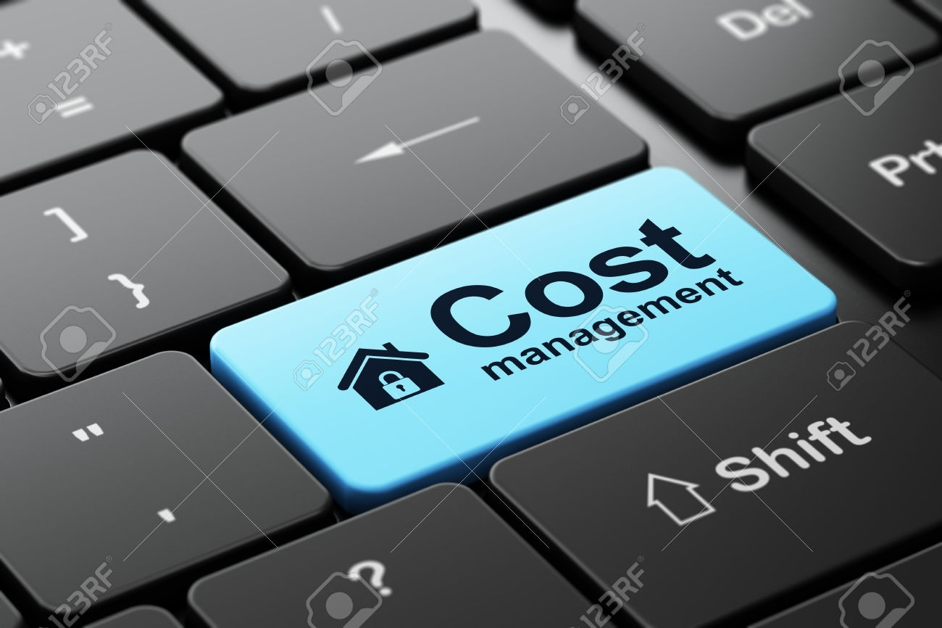
37th Cost Conference 2016, Kolkata
Managing Cost and Taking Successful Business Decisions
- Core Competency of CMAs
A Power Sector Perspectives
By K.P. Gupta
GM-Finance, NTPC Limited

Slide 2
Indian Power Sector – Main Features
Electricity is the key enabler of country’s development
It is highly regulated – CERC, SERCs
It is highly capital intensive
Power Value Chain – Equipment manufactureres, Fuel supplier, Generator, Transmission, Distribution.
Input driven – Coal, Gas, Renewables including Hydro etc.
Electricity generated can not be stored

Slide 3
Investors Expectation – 5 R
Return on Capital Employed
Return of Capital net worth
Reimbursement of prudent operating expenses.
Reward to efficient performer
Reduction in Regulatory Uncertainties

Slide 4
Consumer Interest-What does it mean ?
In my view:
Access to Electricity
Availability of Electricity
Assured Quality of Electricity
Attentive to Services
Affordable Price
Regulators and Generators have to strike a balance between the interest of consumers and investors to ensure consumer interest is protected and Investment in the sector is ensured.

Slide 5
………………A tough Job
Optimal cost solution for Power
Does not have
“Simple solution”

Slide 6
GOI initiatives for Affordable Power
Tariff setting by Regulations by Regulators
Amendments in Tariff Policy : focus on 4 Es:
Electricity for all,
Efficiency to ensure affordable tariffs,
Environment for a sustainable future,
Ease of doing business to attract investments and ensure financial viability.
Key cost reduction amendments :
Reduce power cost through expansion of existing power plants.
Benefit from sale of un-requisitioned power to be shared allowing for reduction in overall power cost.
Transmission projects to be developed through competitive bidding process - lowering cost.
“Time of Day” metering, reduce theft and allow net-metering.
Lower power cost by creating transmission capacity for accessing power from across India.
UDAY Scheme : Financial Relief package for Discoms to reduce debt burden and cost of debt. To have positive impact on demand.
Reverse auction of Coal Blocks
Coal Swapping – source coal from nearest mine and reduce transportation costs
Cheap Domestic Coal Production step up – CIL to enhance coal production restricted coal import
Tax Free Bonds for Renewable Energy
Host of Incentives for Renewable Energy – Viability Gap Funding, Solar Parks , waiver of Inter state transmission charges , reducing credit risk by PPAs with strong companies like NTPC , SECI ; allow bundling of low cost thermal with renewable energy

Slide 7
Bulk Power Tariff: Basic
Long Term Power Purchase Agreements
Tariff Regulations for Five Years
Two-part Availability Based tariff
Capacity Charge (recovery of normative fixed charges such as O&M cost,Depreciation,Interest on Fixed Loan, Interest on Working Capital and return on Equity)
Energy Charge (recovery of normative primary and secondary fuel costs)
Incentive allowed separately for performance better than norms.
Corporate Commercial Department

Slide 8
Cost Management in NTPC
CAPEX
Hard costs : Cost of land, equipment costs, townships, civil works etc.
Soft Costs : Establishment Expenditure during construction-IEDC , Interest during construction- IDC
OPEX
Depreciation, Fuel Costs, O&M (including establishment, R&M)
Finance Costs : Interest on Loan and Working Capital
Efficient operation
High efficiency in construction and operation
Cost Management starts from conception stage

Slide 9
Cost Optimization Strategies- Capex
Project Management
Cost Reduction Strategy
State of the art IT enabled monitoring mechanism
3 Tier monitoring mechanism
Web based platforms for regular reviews and flagging off critical issues
IP based cameras installed
Apex level review of critical issues identified during project & Regional reviews
Milestone based monitoring
Low Borrowing Cost strategy
Mix of Domestic Loans (42%) ,
ECB (30%) , Domestic Bonds (28%)
Low cost tax free bonds (sub g-sec)
Optimization of Power Plant Layout
Induction of New Technology to optimize cost
Mode of Tendering
Reverse Bidding – e-bidding to maximize price tension ; adopted in coal mining MDO appointment, civil packages , solar packages
Innovative Packaging
Vendor Meets
Bulk Tendering and Packaging
11 units of 660 MW and 9 units of 800 MW
26 Packages Model- All packages awarded separately.
EPC Package Model – Turnkey contract
BTG and BOP Packages Model – 2 packages
SG Island, TG Island and BOP Packages Model – 3 Packages
Reduction in project cycle time of 500 MW units – Time taken for COD in months

Slide 10
Cost Optimization Strategies- Capex …..contd
Web-Based Milestone Monitoring System (WEBMILES ©) – access given to MoP, CEA & NTPC Management
Project Review & Internal Monitoring System (PRIMS ©) – access given to NTPC Management & concerned functional departments in NTPC.
Enterprise Issue Tracking System – collaborative platform to resolve critical issues holding project progress.
Project Planning & Monitoring Network – through SAP (PS Module)
IP Cameras installed at critical locations at site with remote operation.
Video Conference with 32 sites at a time, with presentation in dual mode.
SMS Broadcast system for Daily morning reporting & other updates/alerts.
PP&M website – an approach towards paper-less office.

Slide 11
Cost Optimization Strategies- Opex
COST OF Power Generation is around 70% of total cost of power to distribution utility
NTPC, Expenditure on fuel constitutes 80% of the total expenditure on operations
Cutting Coal Imports : Slashing coal import by 30% reduced from 12.3 million tons to 8.6 million tons resulted in reduced average cost of electricity
Fuel Swapping : The company has also rationalised coal supplies by moving coal from the nearest mine to a generation station rather than sourcing the coal from the distant mine the unit is tied-up with. This reduces freight.
Reduced procurement from e-auction : coal procurement from e-auction has also been cut
Implementation of Third Party sampling by CIMFR for determination Calorific value of Coal for price determination and payment.
Transportation of Coal through Inland Waterway Authority in place over burdened Railway network
Coal Block development d and operation through competitively appointed MDO will ensure fuel security and low coal cost for NTPC plants
. Transmission of Power in place of Transportation of Coal New power Station at Pit head

Slide 12
Cost Optimization Strategies- Other Opex
Major components of O&M costs
Employee Cost:
Focus area of control for NTPC management – striving to bring it down – generally form 5% of revenue .
Productivity of employees improved - reflected in the Man:MW Ratio improvement- from 0.80 in Financial Year 2010-11 to 0.55 in Financial year 2015-16 on commercial capacity.
Commercial Generation per employee was 11.13 MUs during 2015-16 based on generation of NTPC stations.
Target Man:MW ratio by 2021-22 is 0.3 (benchmarked with world’s best utilities)
Over 5 years number of employees have reduced
23797
24011
23865
23411
22496
21633
Revenue from opn per employee has grown from Rs.2.58 crore to Rs. 3.24 crore over 5 years
Value Added per employee has gone up from Rs.0.80 cr in FY11 to Rs.1.29 cr in FY16
Profit per employee has grown from Rs.0.38 crore to Rs.0.46 crore
Man: MW Ratio has improved from 0.80 in FY11 to 0.55 in FY16
Executives Attrition Rate 1.35% in FY15
FY11
FY12
FY13
FY14
FY15

Slide 13
Cost Optimization Strategies- other Opex Cont..
Major components of O&M costs
Repair and Maintenance Cost:
With the aim of improving system wide reliability, reducing maintenance costs and outages, Special Analytics and Computational Services Centres established - provides early warning of slowly evolving equipment problems to the remotely located plant personnel.
Use of Process Interface (PI) System and PI System based applications for real time efficiency and loss calculation for ensuring early actions to minimise stations losses.
Sales & Administration Expenses:
The company has implemented an Enterprise Resource Planning (ERP) package – includes e-procurement, knowledge Management, Business Intelligence, Document Management and workflow etc. Parallely, in house IT solutions have been developed to take care of the non ERP areas.
O&M costs are recovered on Normative basis – any adverse variation from norm results in under recovery and impacts profitability

Slide 14
Surplus power in India
Power Projects established not getting Schedule
Increasing Competition among generators
Short term power being traded in Power exchanges
Power Companies generating at reasonable cost are allowed to supply power
Cost Management is need of hour
Big Opportunity for CMAs

Slide 15
Thank you

