Slide 1
Union Budget - 2016 – service tax changes –

Slide 2
Key Highlights :
No specific time line on Goods and Service tax ( GST ).
No change in median rate of Basic Customs, Excise duty & Service tax.
Introduction of a new cess – Krishi Kalyan Cess @ 0.5% on all taxable services ( w.e.f 1st June , 2016 ) and the credit on the same is available.
Rationalisation of interest rates in respect of Customs, Central excise & Service tax @15% p.a. ( Small service providers @ 12%) and 24% p.a. in case service tax collected but not deposited to Government.
All capital goods having value up to Rs 10000 per piece are being included in the definition of inputs.
Filing of Annual return Service tax & Central Excise assesses above a certain threshold , effective from 1st April, 2016.
Facility for revision of return to Central excise assessees.
Indirect tax Dispute Resolution Scheme, 2016 to minimise litigation.
11 new benches of CESTAT.
Indirect tax proposals are expected to yield Rs 20,670 crores of Revenue.

Slide 3
Rate of Service tax and Cess

Slide 4
Legislative changes in Service tax
Negative List ( Sec 66D ) :
Specified educational services ( i.e. pre-school education, HS education etc) and the definition of ‘Approved vocational education course’ ( i.e Courses run by ITI , ITC affiliated to National Council for Vocational Training ) are proposed to be omitted. However, the same being incorporated in the general exemption notification ( viz. 25/2012 –ST dated 1st March, 2016 )
Service of transportation of passengers, with or without accompanied belongings, by a stage carriage is proposed to be omitted ( w.e.f. 1st June, 2016 ) . Service by non-air-conditioned stage carriage will be exempted by way exemption notification ( 25/2012 – ST ) while Service by air-conditioned stage carriage will be taxable with 60% abatement(CENVAT not availed.
Service by way of Transportation of goods by an aircraft or a vessel from a place outside India up to customs station of clearance omitted (w.e.f 1st June, 2016) . However, such service by aircraft will continue to be exempted. Domestic Shipping line ( FC) , Foreign Shipping line (RC).

Slide 5
Legislative changes in Service tax
Declared services ( Sec 66E )
Assignment by Government of the right to use the radio-frequency spectrum ( 9KHz to 3000 GHz ) as well as subsequent transfers of assignment of such right to use is a service leviable to service tax and not sale of intangible goods.
CENVAT credit of Service tax paid on amount charged for assignment by Government or any other person of a natural resource such as radio-frequency spectrum shall be spread over the period of time for which the rights have been assigned.
Where the manufacturer or output service provider further assigns such right to another person against a consideration , balance CENVAT credit not exceeding the Service tax payable on the consideration charged by him , shall be allowed in the same financial year.

Slide 6
Legislative changes in Service tax
Arrest and Prosecution :
The power to arrest under the Act is proposed to be restricted only to situations where the assessee has collected tax but not deposited with the Central Government, and the amount of such tax is more than Rs 2 crores from existing limit of Rs 50 Lacs.
Lottery :
Definition of ‘Service’[Sec 65B(44)] is proposed to be amended to include any activity carried out by a Lottery distributor or Selling agent in relation to promotion , marketing, organizing, selling of lottery or facilitating in organising lottery of any kind, in any other manner, of the State Government as per the provisions of the Lotteries (Regulation) Act, 1998 is leviable to Service tax.
Rate of Service tax (Sec 67A) :
Sec 67A is proposed to be amended to obtain specific rule making powers in respect of POTR, 2011.POTR, 2011 is being amended accordingly.

Slide 7
Legislative changes in Service tax
Rate of Service tax (Sec 67A) :
A new sub-section (2) being inserted to empower the Central Government to prescribe the time or the point of time with respect to the rate of service tax.
The above proposed amendment has specifically enabled the Central Government to make rules and has linked the POT Rules with Sec 67A. Hence, the POT Rules shall remain relevant for determining rate of Service Tax as well as due date of payment of tax. ( w.e.f. the date of enactment of the Finance Bill, 2016 )
Power to grant Rebate ( Sec 93A ) :
Amendment made so as to enable allowing of rebate by way of notification as well as rules ( viz. Rule 6A of Service Tax Rules ).
Export Refund ( Notification No. 1/2016 –ST ):
Refund of Service tax on services used beyond the factory or any other place or premises of production or manufacture of the said goods for export of the said goods.

Slide 8
Legislative changes in Service tax
Export Refund :
The said amendment is being given retrospective effect from the date of application of parent notification ( 41/2012 –ST ) i.e. 01.07.2012.
Time period of one month from the date of commencement of the Finance Act, 2016, is proposed to be allowed to the exporters whose claims of refund were earlier rejected .
One Person Company ( Sec 2(62) –CA 2013) :
Concept of One Person Company (OPC) was introduced to support entrepreneurs who on their own are capable of starting a venture by allowing them to create a single person economic entity with limited liability.
The benefits of (a) quarterly payment of service tax and (b) payment of service tax on receipt basis ( aggregate value of service up to Rs 50 lacs in the PFY ) are being extended to OPC.
Similar benefit is also being extended to HUF.

Slide 9
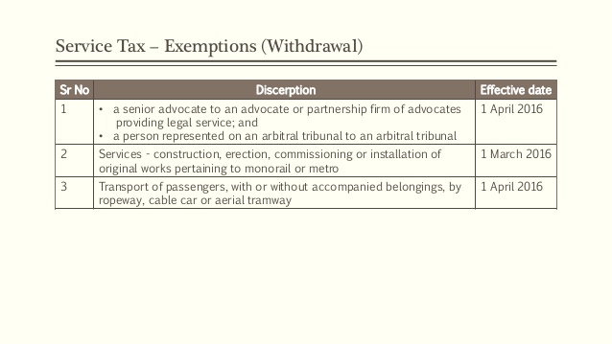

Slide 10
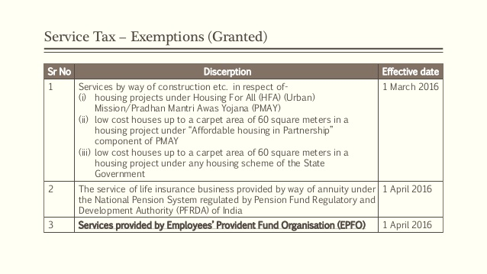

Slide 11
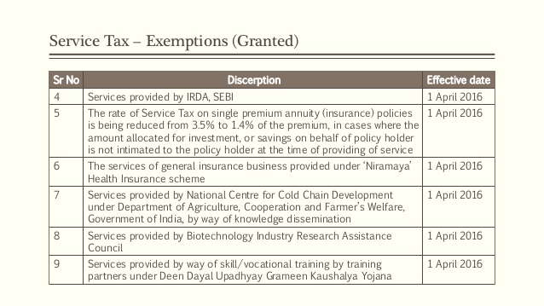

Slide 12
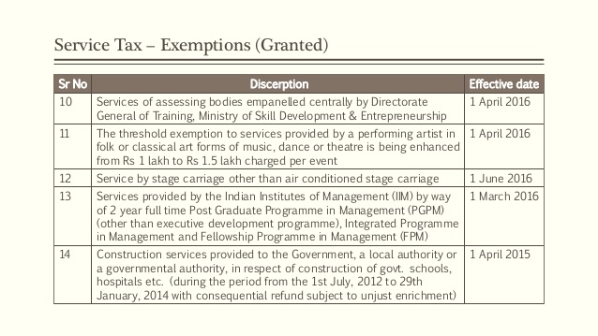

Slide 14
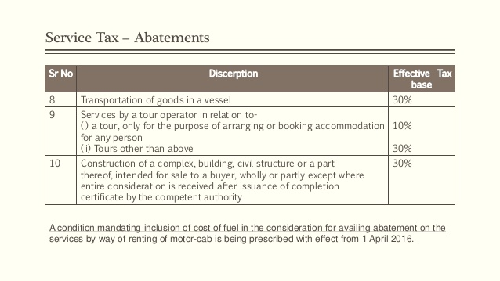
CENVAT credit on Input Services available in case of Transportation of goods by Rail & Vessel i.e Serial No. 1, 2, 3 & 8

Slide 15
Other Changes in Service Tax
Reverse Charge Mechanism :
In Union Budget 2015, Services provided by Mutual Fund agents / distributors to asset management company were put under reverse charge liability for such asset management companies. Now, services provided by Mutual Fund agents / distributor to a Mutual Fund or asset management company, are being put under forward charge.
Moreover, Small sub-agents down the distribution chain will be eligible for small service provider exemption ( Threshold turnover of Rs 10 lakh/year ) therefore a very small number will be liable to pay Service tax.
The liability to pay service tax on any service provided by Government or a local authority to business entities shall be on the service recipient.
Consequently , notification No 30/2012 –ST is being amended so as to delete the words ‘by way of support services’ w.e.f 1st April , 2016.

Slide 16
Other Changes in Service Tax
Information Technology Software :
Service tax on Information Technology Software on media bearing RSP is being exempted from Service tax w.e.f. 1st March, 2016 provided Central excise duty is paid on RSP in accordance with Sec 4A of Central Excise Act, 1944.
However, media with recorded Information Technology Software which is not required to bear RSP ( e.g. Customised IT Software ) , is being exempted from so much of the Central excise duty / CVD as is equivalent to the duty payable on the portion of the value of such IT Software recorded on the said media , which is liable to Service tax.
In such cases, manufacturer or importer is required to pay Central excise duty / CVD only on the portion of value representing the value of the medium on which it is recorded along with freight and insurance.

Slide 17
Other Changes in Service Tax
Incentives received by Air travel agents from Computer Reservation System Companies (CCRS) :
Incentives received by the Air Travel Agents from the companies providing Computer Reservation System (CCRS) are for using the software and platform provided by the CCRS like Galileo, Amadeus etc .
The CCRS are providing these incentives either for achieving the targeted booking of air tickets or for loyalty for booking of air tickets using their software system.
Thus, Air Travel Agent is promoting the service provided by CCRS to Airlines. This service is neither covered in the negative list nor exempt by notification. Therefore, service tax is leviable on the same.

Slide 18
Other Changes in Service Tax
Services provided by Container Train Operators (CTO) :
Service provided for transport of goods in containers by any person other than Indian Railway (e.g. Adani Logistics Ltd, Hind Terminals Ltd etc.) shall be eligible for abatement of 60% with credit of input services.
Moreover, the services provided by the Indian Railways to CTO of haulage of their container train ( rake of wagons with containers ) is a service of ‘Transport of Goods by Rail’ and is therefore , eligible for abatement of 70% and tax treatment accordingly.

Slide 19
Other Changes in Service Tax
Services provided by Institutes of Language Management(ILM)
Institutes of Language Management are engaged by various schools/institutions to develop knowledge and language skills of students.
However, the services provided by the ILMs are not covered under Section 66D (l) as they are not providing pre-school education or education up to higher secondary school (or equivalent) or education for obtaining a qualification recognised by law. It is the schools / college / institutions which provide such education
Thus, the services provided by the Institutes of Language Management (ILMs) are not eligible for exemption under section 66D(l).

Slide 20
CENVAT Credit – Input Service Distributor
The scope of Input Service Distributor (ISD) has been widened and now ISD can distribute input service credit to an outsourced manufacturing units also in addition to its own manufacturing units ( w.e.f. 1st April, 2016)
Outsourced manufacturing unit is being defined to mean either a job-worker who is required to pay duty on the value determined under rule 10A of the Central Excise Valuation ( Determination of Price of Excisable Goods) Rules, 2000, on the goods manufactured for the ISD or a manufacturer who manufactures goods for the ISD under a contract, bearing the brand name of the ISD and is required to pay duty on value determined under section of the Central Excise Act,1944.
The credit of Service tax paid on input services, available with the ISD as on 31st of March, 2016 shall not be distributed to an outsourced manufacturing unit.
Provision of rule 6 of Cenvat Credit Rules, 2004 relating to reversal of credit in respect of input and input services used in manufacture of exempted goods or provision of exempted services, shall apply to the units availing the CENVAT credit distributed by ISD and not to the ISD.

Slide 21
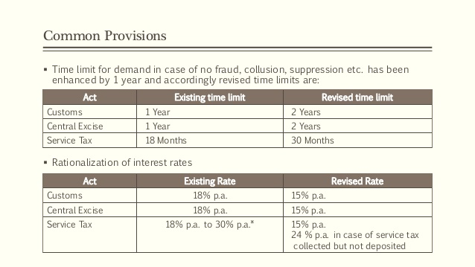

Slide 22
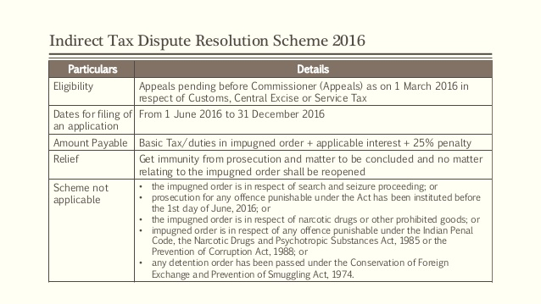

Slide 23
** Thank you **
CMA Abhijit Khasnobis
Practicing Cost Accountant

